Slide 1
NEURAL
STYLE
TRANSFER
...another DeepLearning Magic

Slide 2
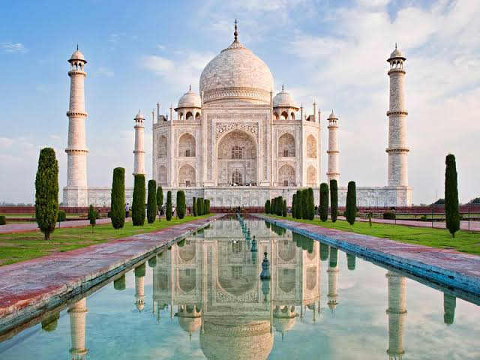
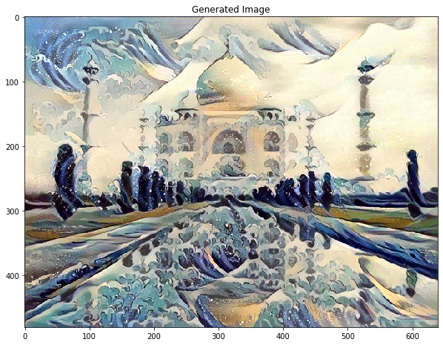
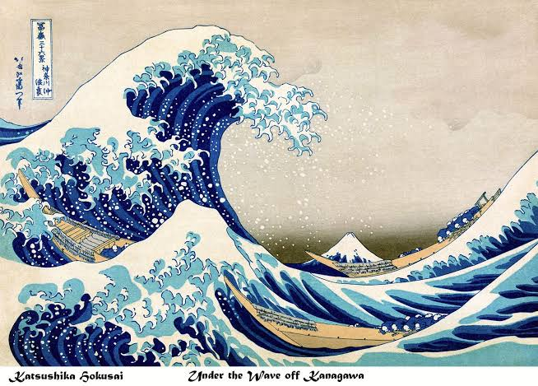
What are we going to CREATE?
Content Image
GeneratedImage
Style Image

Slide 3


1. Intro
NST is an optimization technique which takes two images, a content image and a style reference image (such as an artwork by a famous painter) and blend them together such that the generated image is transformed to look like the content image, but “painted” in the composition of the style image.

Slide 4
What all do you need to know
to do this kinda stuff?

Slide 5
Just one! Transfer Learning.
(With a little help from me, ofc ;)

Slide 6


Out of a billion Pre-trained models Keras provide, VGG - 19
is the one we we’ll be using.

Slide 7
2. Procedure
Define Different Costs
Create Generated Image
Extracting Features out of the Model
Compute and Apply Gradients
Update Generated Image
View the Best Image
Plot the Logs

Slide 8
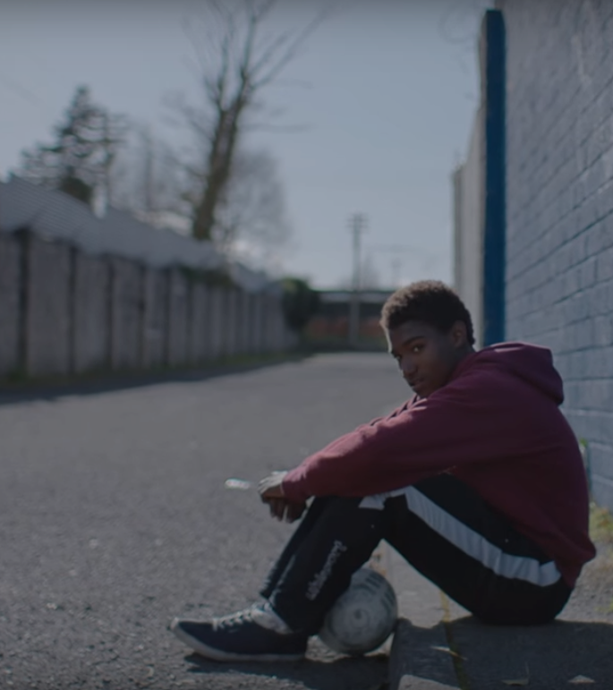

Cost Function
Total Cost
= 𝞪.Content Cost + 𝞫.Style Cost

Slide 9
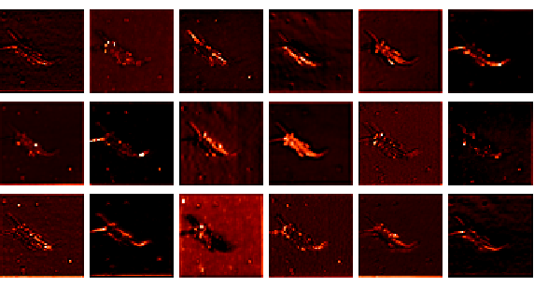
Feature Extraction is the interpretation of what the Network sees in an image.

Slide 10


Slide 11

Ok ok...
f“{Link to Colab}”
*did you see what I did there?

Slide 12
Thank you!
I hope you liked what you saw.
Feel free to pitch in any idea and we’ll try to work on that!
~ Parthik Bhandari
connect2parthik@gmail.com

